Slide 1
OpenGL Transformations
Advanced Graphics Programming

Slide 2
Dot and Cross products

Slide 3
Dot product
The dot product of two vectors A and B is defined as:
B
A · B = |A| |B| cos θ
dot(A, B) = length(A) * length(B) * cos(θ)
θ
O
A
dot(A, B) = Ax * Bx + Ay * By + Az * Bz

Slide 4
Dot product
The result of the dot product is a scalar value.
It denotes the degree of projection of one vector onto the other.
If A is normalized (i.e. |A| == 1), dot(A, B) gives us the amount of B projected onto A.
B
θ
O
A
dot(A, B)
dot(A, B) = Ax * Bx + Ay * By + Az * Bz

Slide 5
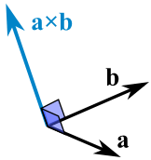
Cross product
The cross product of two vectors A and B is defined as:
A ⨉ B = |A| |B| sin θ N
cross(A, B) = length(A) * length(B) * cos(θ) * N

Slide 6
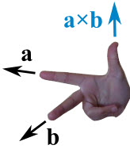
Cross product
It gives us a vector which is perpendicular to both A and B.
The Right Hand Rule tells us the direction of the resulting vector.

Slide 7
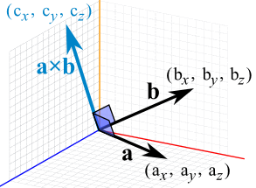
Cross product
The cross product of two vectors A and B can be computed as follows:
c_{x} = a_{y}b_{z} − a_{z}b_{y}
c_{y} = a_{z}b_{x} − a_{x}b_{z}
c_{z} = a_{x}b_{y} − a_{y}b_{x}

Slide 8
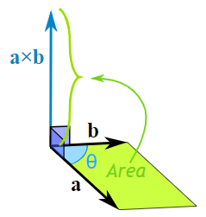
Cross product
The magnitude of the resulting vector is the area of the parallelogram defined by A and B.

Slide 9
Cross product
The magnitude of the resulting vector is the area of the parallelogram defined by A and B.
Most of the time we will be interested in the resulting vector direction, not magnitude, so remember to normalize the result before using it.

Slide 10
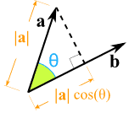
Dot product vs. Cross product
Dot product Result: A scalar value Projection of a onto b Normalize b to find the projection measure in the current base coordinates. | Cross product Result: A third vector Perpendicular to a and b Area of the parallelogram Right Hand Rule

Slide 11
Vertex transformations pipeline

Slide 12
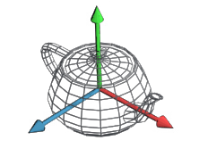

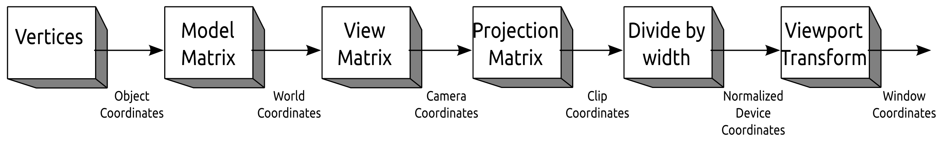
Vertex transformations pipeline
The local coordinates of an object (or object coordinates) are its coordinates as read from the file generated with the 3D modeling software.

Slide 13
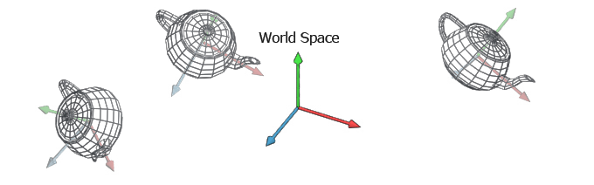
Vertex transformations pipeline
The world coordinates, are the coordinates of an object with respect to the world space.
We use the world matrix (or model matrix) to transform from local coordinates to world coordinates.

Slide 14
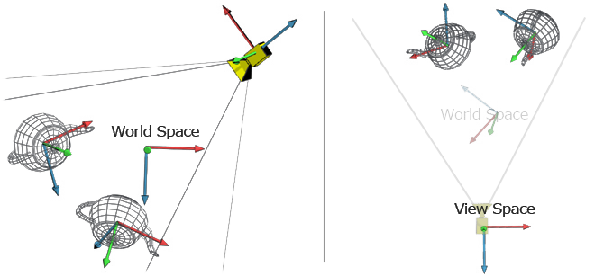
Vertex transformations pipeline
The camera coordinates, are the coordinates of an object with respect to the camera space (also eye coordinates, or view coordinates).
We use the view matrix (or camera / eye matrix) to transform from world coordinates to camera/eye/view coordinates.

Slide 15
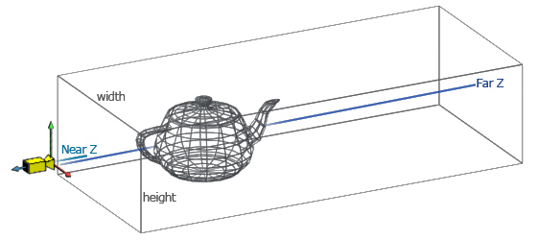
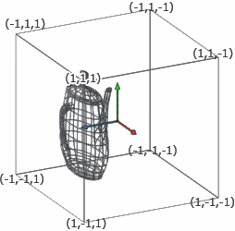
Vertex transformations pipeline
The NDC coordinates, are the coordinates of an object after projection and perspective division.
We use the projection matrix to transform from view coordinates to clip coordinates.
We then perform the perspective division (x/w, y/w, z/w) to obtain the NDCs.
Orthographic or parallel projection
projection and perspective division

Slide 16
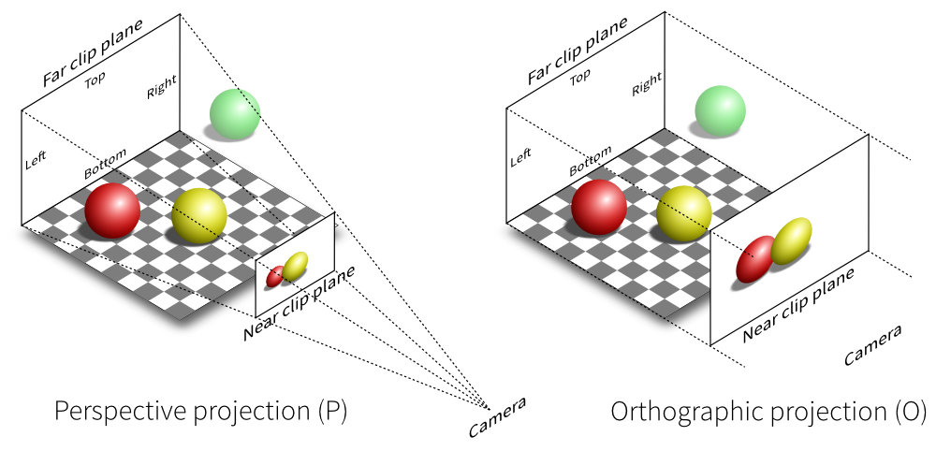
Vertex transformations pipeline
The NDC coordinates, are the coordinates of an object after projection and perspective division.
We use the projection matrix to transform from view coordinates to clip coordinates.
We then perform the perspective division (x/w, y/w, z/w) to obtain the NDCs.
Orthographic or parallel projection

Slide 17
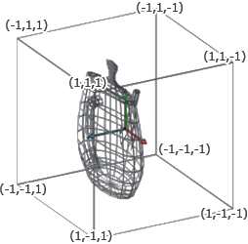
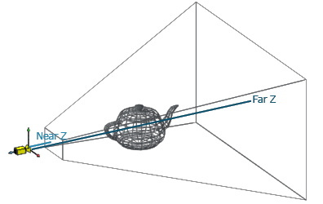
Vertex transformations pipeline
The NDC coordinates, are the coordinates of an object after projection and perspective division.
We use the projection matrix to transform from view coordinates to clip coordinates.
We then perform the perspective division (x/w, y/w, z/w) to obtain the NDCs.
Perspective projection
projection and perspective division

Slide 18
Vertex transformations pipeline
The NDC coordinates, are the coordinates of an object after projection and perspective division.
We use the projection matrix to transform from view coordinates to clip coordinates.
We then perform the perspective division (x/w, y/w, z/w) to obtain the NDCs.
Perspective projection

Slide 19
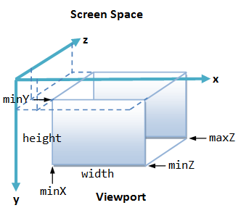
Vertex transformations pipeline
The window coordinates, are the coordinates of an object after its viewport transformation.
The viewport transformation is carried out by a fixed part of the pipeline. Controlled by these functions:
glViewport()
glDepthRange()

Slide 20
Transformation matrices

Slide 21
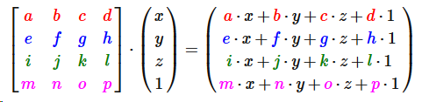
Homogeneous coordinates
To simplify calculations, in OpenGL we use homogeneous coordinates.
4 x 4 matrices
4 component points and vectors
Points: (x, y, z, 1)
Vectors: (x, y, z, 0)

Slide 22
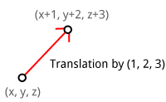
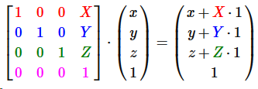
Translation matrix
Notice how it can only affect to points
vectors, whose 4th component is 0, are not affected by translations

Slide 23
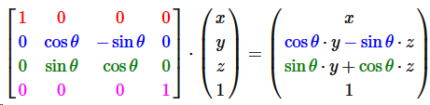
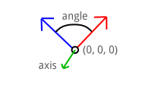
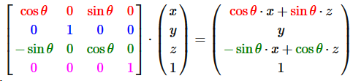
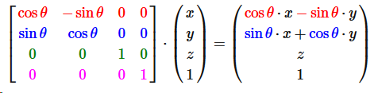
Rotation matrices
They affect to both points and vectors.

Slide 24
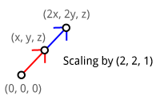
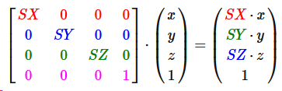
Scale matrix
They affect to both points and vectors.

Slide 25




Geometric transformation matrices in Qt

Slide 26
View/camera matrix
If we had a camera entity in our scene
Its world matrix converts from camera to world space
Its view/camera matrix converts from world to camera space
Both matrices are actually the inverse of each other
We can compute the view matrix directly with the lookAt function:
Or computing the inverse of the camera entity world matrix with the function:

Slide 27
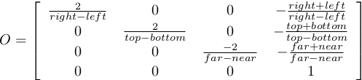
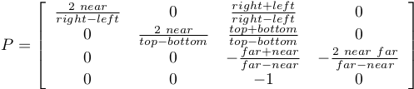

Projection matrices
Orthographic or parallel projection
Perspective projection
With left, right, bottom, top, near, and far
Perspective projection
With fovy, aspect, near, and far

Slide 28

Projection matrices in Qt

Slide 29
Bonus slide

Slide 30
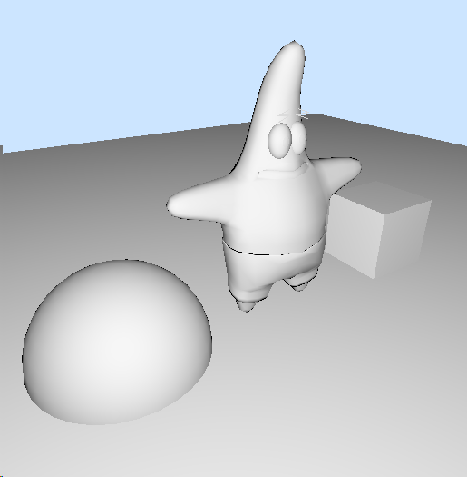
We can already place objects in the world
With the tools given so far (and in other subjects ehem ehem…) you should be able to visualize simple scenes like this one with our friend Patrick.
#version 330 core
layout(location=0) in vec3 position;
layout(location=1) in vec3 normal;
uniform mat4 projectionMatrix;
uniform mat4 worldViewMatrix;
out Data
{
vec3 positionViewspace;
vec3 normalViewspace;
} VSOut;
void main(void)
{
VSOut.positionViewspace = (worldViewMatrix * vec4(position, 1)).xyz;
VSOut.normalViewspace = (worldViewMatrix * vec4(normal, 0)).xyz;
gl_Position = projectionMatrix * vec4(VSOut.positionViewspace, 1.0);
}
#version 330 core
in Data
{
vec3 positionViewspace;
vec3 normalViewspace;
} FSIn;
out vec4 outColor;
void main(void)
{
vec3 L = -normalize(FSIn.positionViewspace);
vec3 N = normalize(FSIn.normalViewspace);
vec3 albedo = vec3(1.0);
float kD = max(0.0, dot(L, N));
outColor.rgb = albedo * kD;
outColor.a = 1.0;
// Gamma correction
outColor.rgb = pow(outColor.rgb, vec3(1.0/2.4));
}

